Slide 1
Land Surface Phenology Project
An application of PARTS
- Clay Morrow
Notes:
This is a brief outline for the motivation behind my phenology project. I’ll start by discussing the ecology, then the statistics, then the data

Slide 2

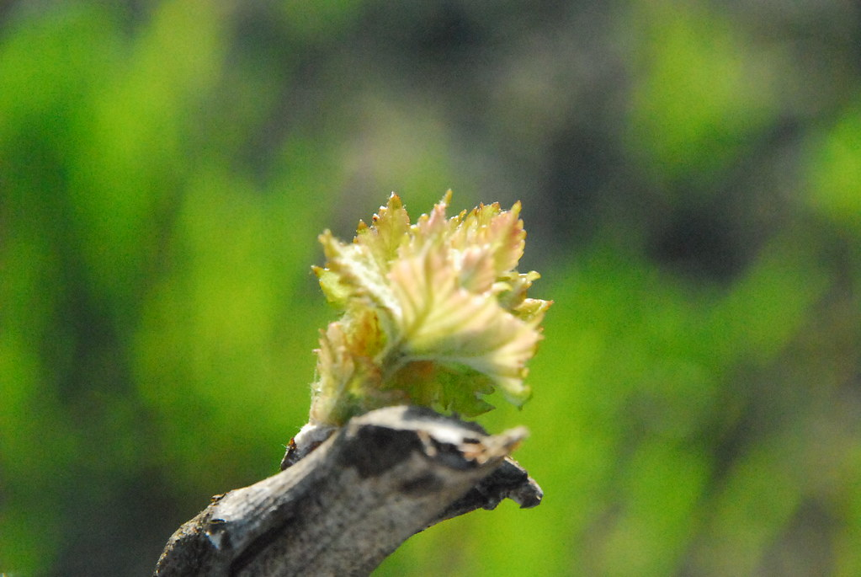
Phenology
Plant phenology depends on climatic factors
Land Surface Phenology (LSP) approximates plant phenology
LSP is spatially and temporally autocorrelated
Growing seasons are getting longer and starting earlier
This Photo by Unknown Author is licensed under CC BY-SA-NC

Slide 3
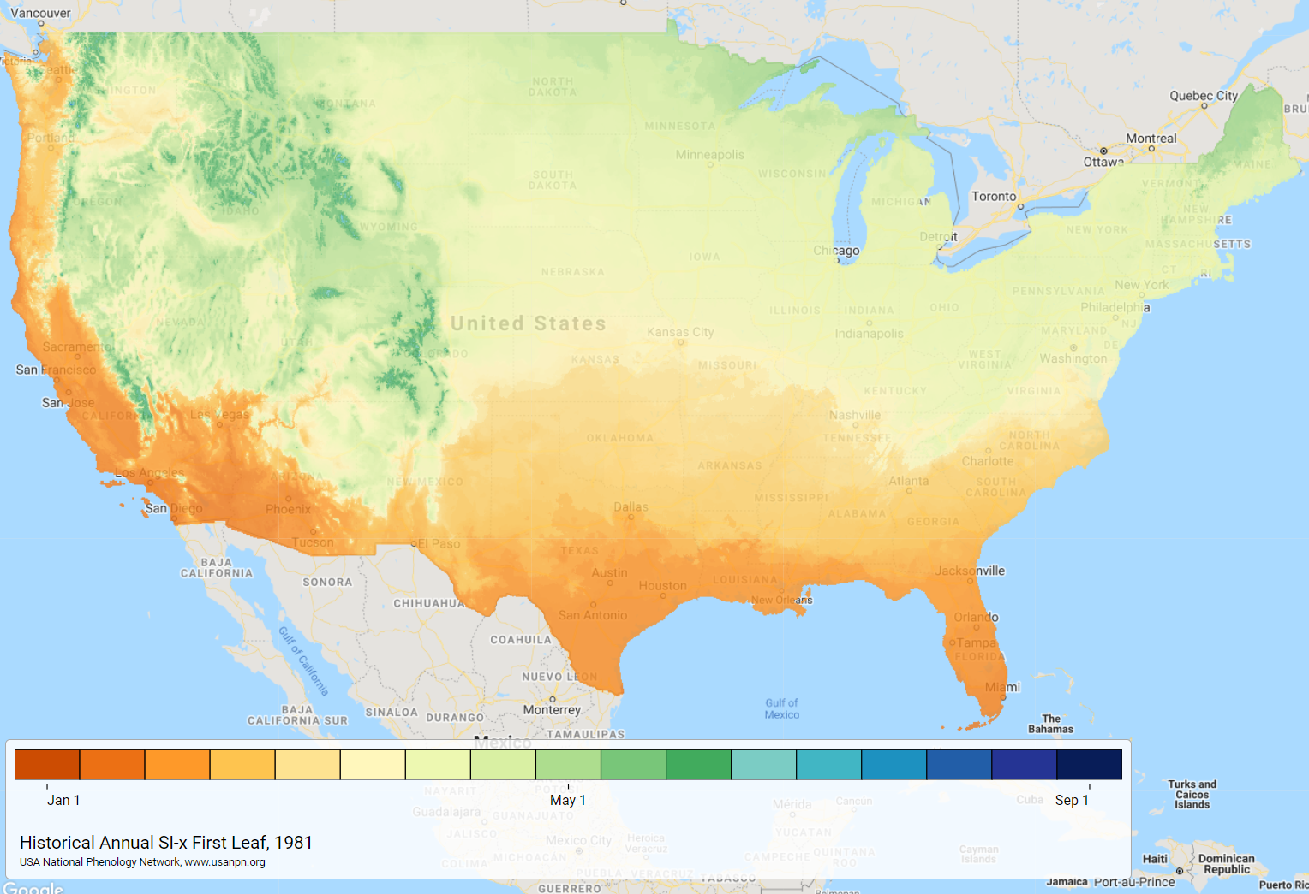
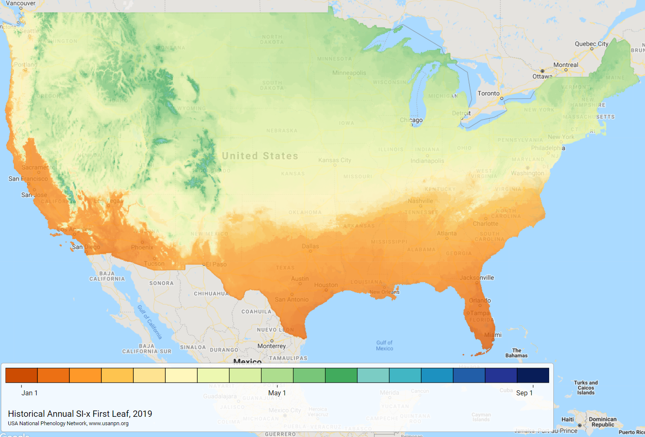

Phenology Example
Earlier leaf onset in 2019 relative to 1981 (averaged among 2 honey suckle and 1 lilac)
Notes:
This is the only premade phenology product I could find that showed temporal differences but are not my data
Data: day on which “fist leaf” conditions were met (using PRISM TMAX and TMIN) data – averaged across 2 species of honeysuckle and a species of lilac.
(PRISM): Climate Group – Oregon State (Parameter-elevation Regressions on Independent Slopes Model)

Slide 4
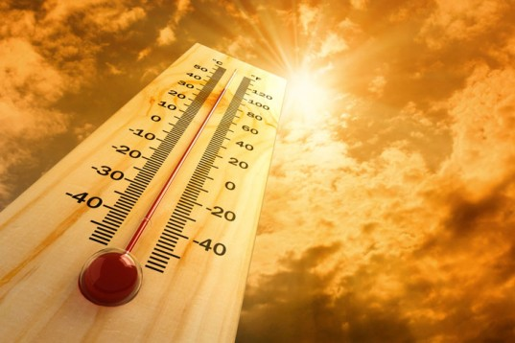
Temperature
Temperature is a primary driver of phenology
Land Surface Temperature (LST) approximates air temperature
LST is spatially and temporally autocorrelated
Global changes in phenology associated with warming climate
This Photo by Unknown Author is licensed under CC BY-NC

Slide 5
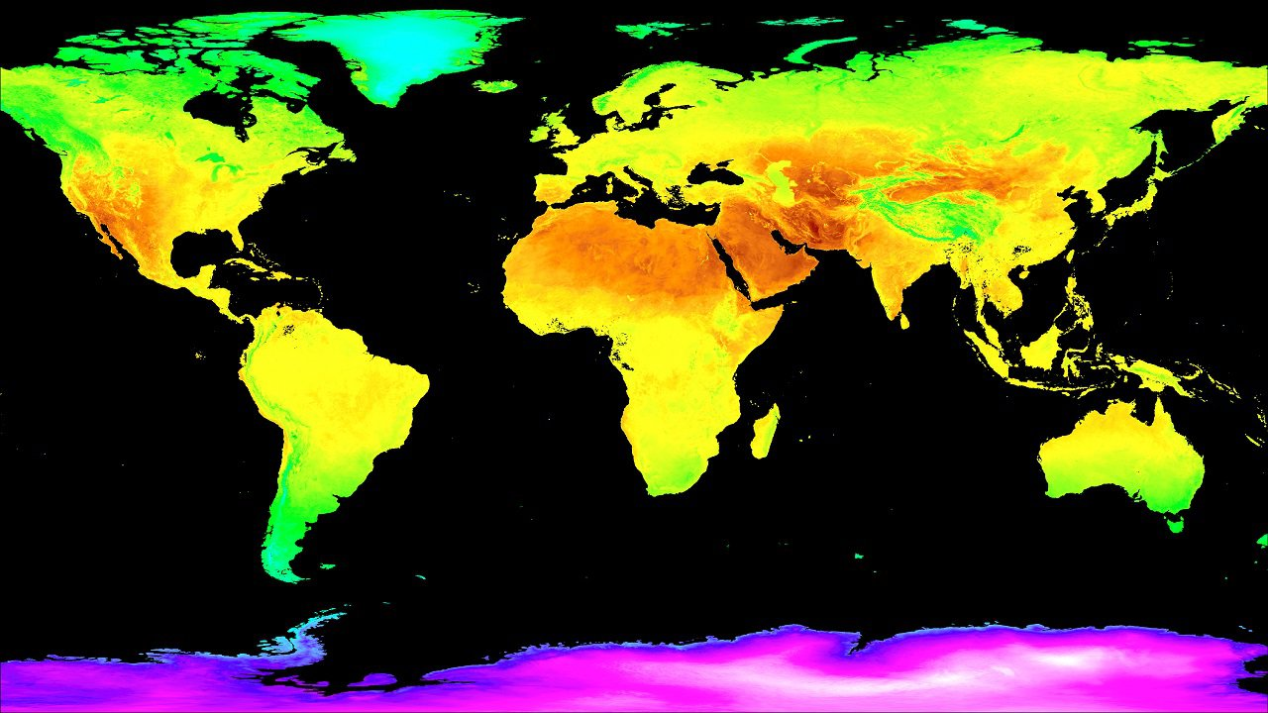
Temperature Example
Notes:
MOD11C3 Global LST product: June 2020

Slide 6

Research Questions
Are growing seasons starting earlier and getting longer at the map level?
Can growing season changes be attributed to temperature changes at the map level?
This Photo by Unknown Author is licensed under CC BY-NC-ND
Notes:
While similar to previous research, I don’t believe these questions have ever been addressed appropriately at the map level.

Slide 7

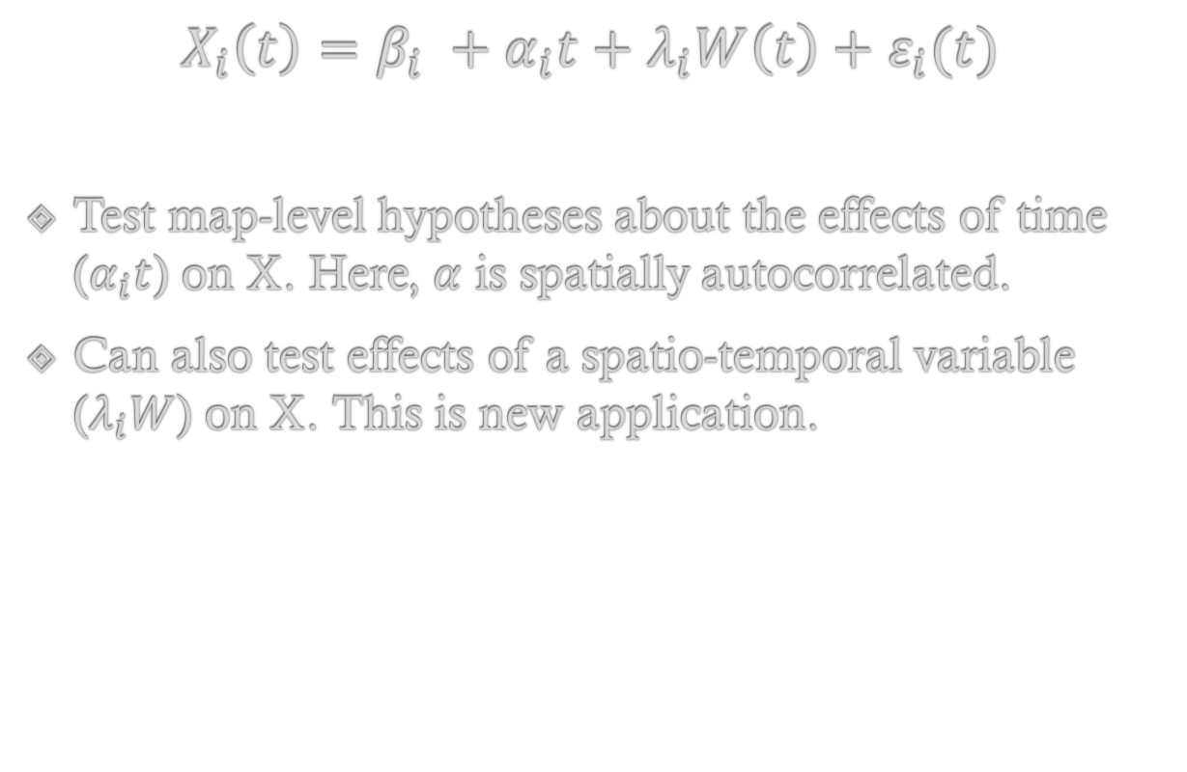
Modified PARTs Model
$$X_{i}\left(t\right)=β_{i} +α_{i}t+λ_{i}W\left(t\right)+ε_{i}(t)$$
Test map-level hypotheses about the effects of time ($α_{i}t$) on X. Here, $α$ is spatially autocorrelated.
Can also test effects of a spatio-temporal variable ($λ_{i}W$) on X. This is new application.
This Photo by Unknown Author is licensed under CC BY-SA-NC
Notes:
* Modified version of PARTS model
* X is a spatio-temporal process generated by an intercept B, an effect of time alpha*t, a spatio-temporal predictor (W), and spatio-temporal errors

Slide 8

Data Requirements
Any data set of manageable size (USA, North America, or US + Canada)
LST and LSP need to be on the same spatial scale
1 LST value per pixel per year: annual or seasonal (i.e., winter or spring)
Minimal pre-processing effort required
This Photo by Unknown Author is licensed under CC BY

Slide 9

Data Sources
MCD12Q2 v006 (LSP):
Premade phenology products (Greenup, MidGreenup, Senescence)
500m, 2001-2018
MOD11C3 v061 (LST):
Temperature products (LST_Day_CMG)
Monthly data (averaged from MOD11C1)
Climate modeling grid (7200 columns, 3600 rows)
2000-2021
Notes:
* Phenology data product derived from enhanced vegetative index EVI2

Slide 10

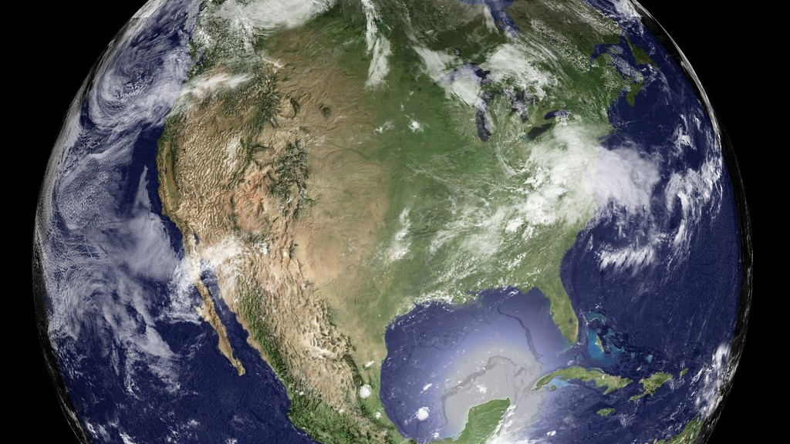
Questions?
This Photo by Unknown Author is licensed under CC BY

Slide 11
Old Slides

Slide 12
Phenology Slides
for NASA meeting
- Clay Morrow

Slide 13
Trends in Phenology
Plant phenology depends on climatic factors
Land Surface Phenology (LSP) approximate plant phenology
Predictors of LSP are spatio-temporally autocorrelated
Evaluate effects of temperature on LSP with PARTS
This Photo by Unknown Author is licensed under CC BY-SA-NC

Slide 14
Predicting Phenology from Temperature
Day at which spring leaf out temperature conditions met: 1981 & 2019
Earlier growing seasons expected with increasing temperatures
Notes:
These data are not the metrics I will use but illustrate the overall trend we expect to see.
These are the day on which “fist leaf” conditions were met (using PRISM TMAX and TMIN) data – averaged across 2 species of honeysuckle and a species of lilac.
(PRISM): Climate Group – Oregon State (Parameter-elevation Regressions on Independent Slopes Model)
Modis 6 data phenology data will probably be used for the analyses (from enhanced vegetative index EVI2)

Slide 15
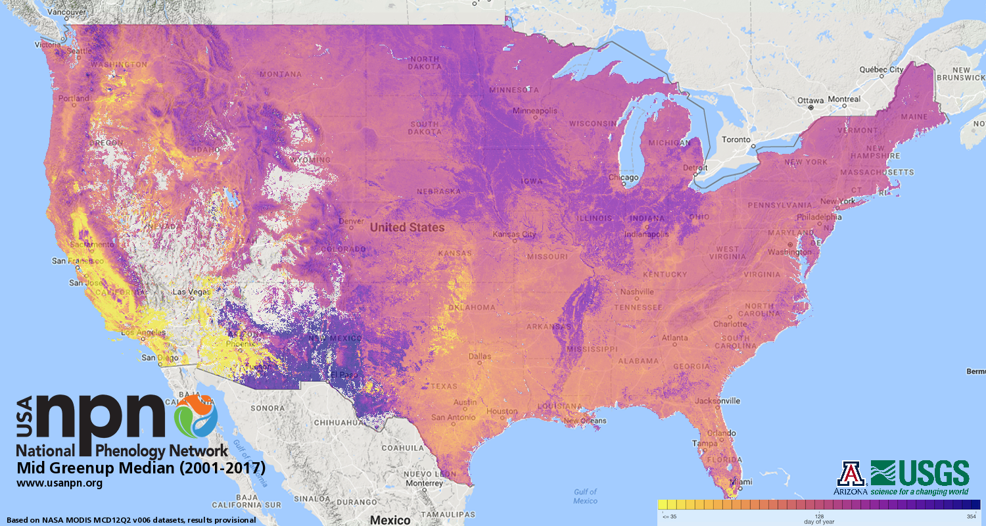
Phenology and Temperature data
LSP Derived from MODIS 6 EVI2
Data exists from 2001-2017 (MCD12Q2 v006)
Compare with MODIS temperature product
Monthly LST product exists from 2000-2021 (MOD11C3 v006)
Notes:
Phenology data is 500m resolution

